Slide 1



What are the effects of deep drawdown at Fall Creek Reservoir?
PART 1:
Physical conditions and resource availability
Christina A. Murphy
Sherri Johnson
Ivan Arismendi
Study Code: JPL 14-02-SYS
(Prior: JPL 13-05-FCR; FP 11-03)

Slide 2
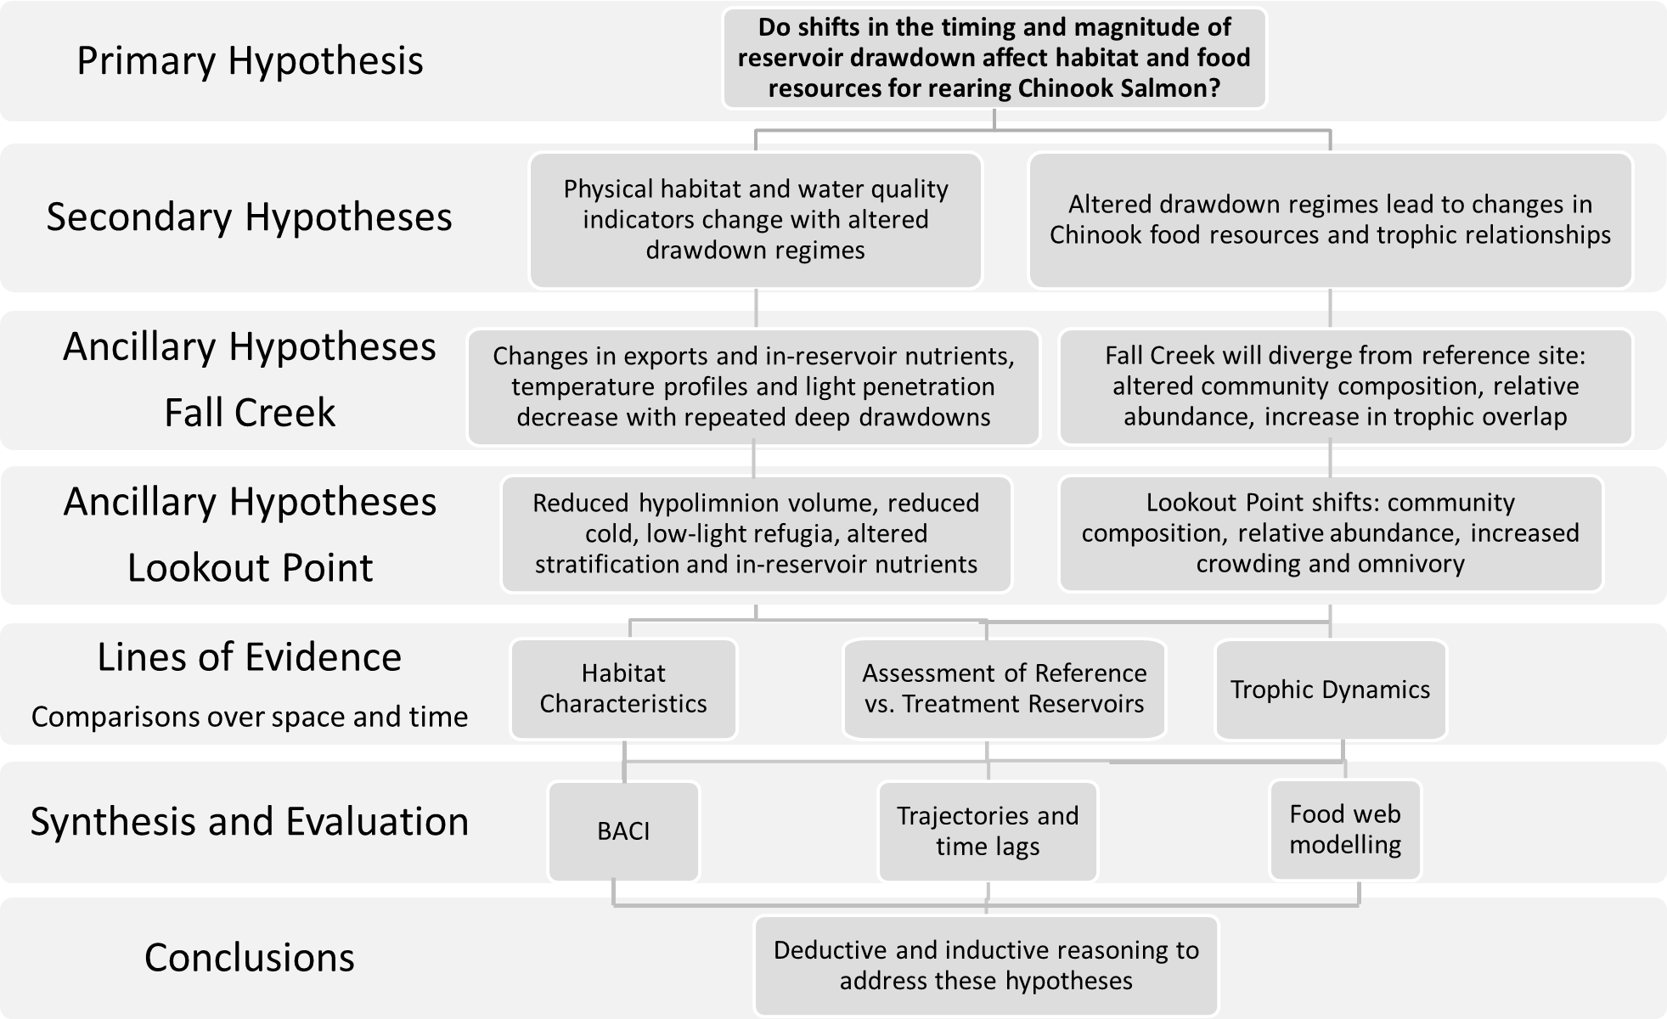
Physical Conditions and Resource Availability for Chinook Salmon
Notes:
SAY HYPOTHESIS!

Slide 3
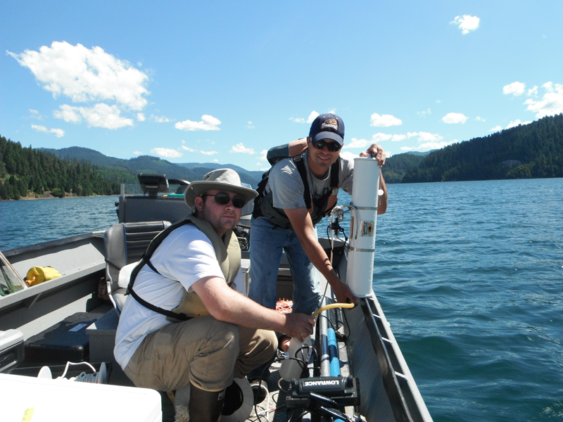
Special Thanks to:
USACE
Lookout Point
Greg Taylor
Todd Pierce
Portland
Cindy Studebaker
Bob Wertheimer
OSU
Brendan Coffin
Brent Johnson
Margaret Whitmore
Randy Wildman
Grad. Committee
Jason Dunham
Angela Strecker
Steve Arnold
ODFW
Michele Weaver
Dan Peck
Springfield
Jeff Ziller
Kelly Reis
Shannon Richardson
Reservoir Dogs
Tom Friesen
Fred Monzyk
Jeremy Romer
Ryan Emig
NOAA
Kim Hatfield
…the RM&E folks and many, many others!
Notes:
screwtrap

Slide 4
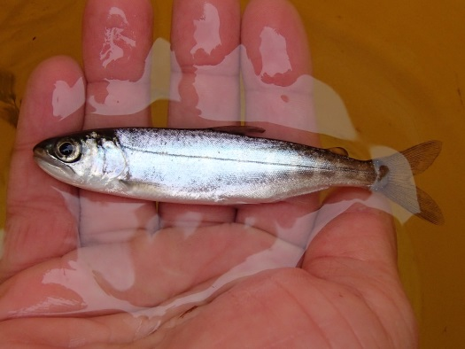

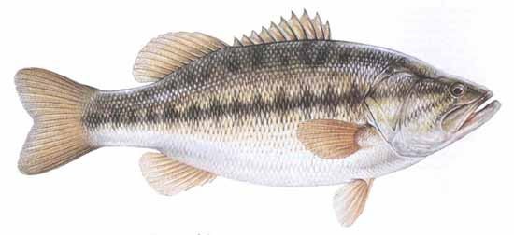
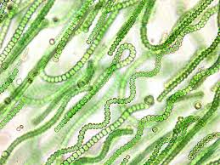
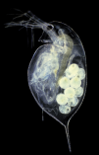
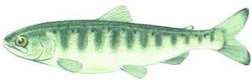
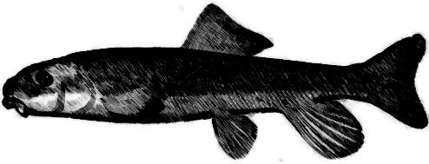
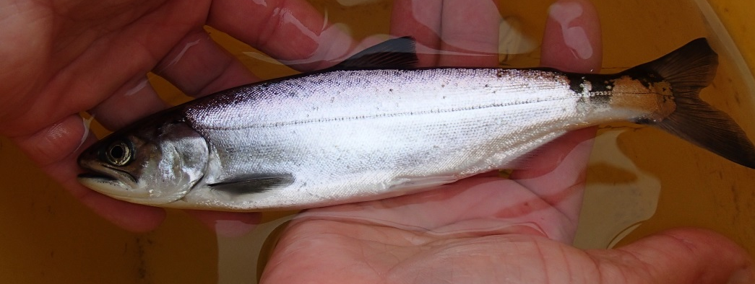
C N P

Slide 5

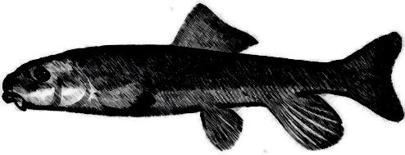
C N P

Slide 6
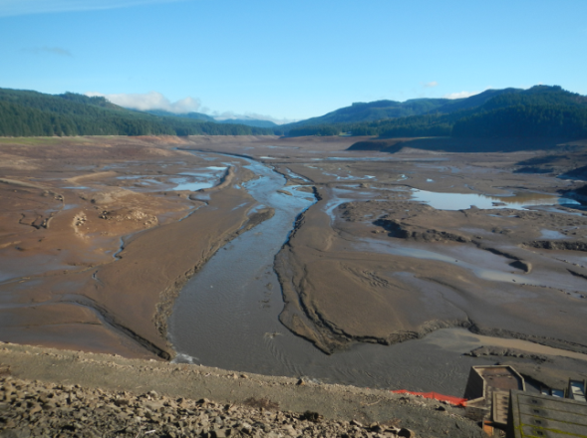
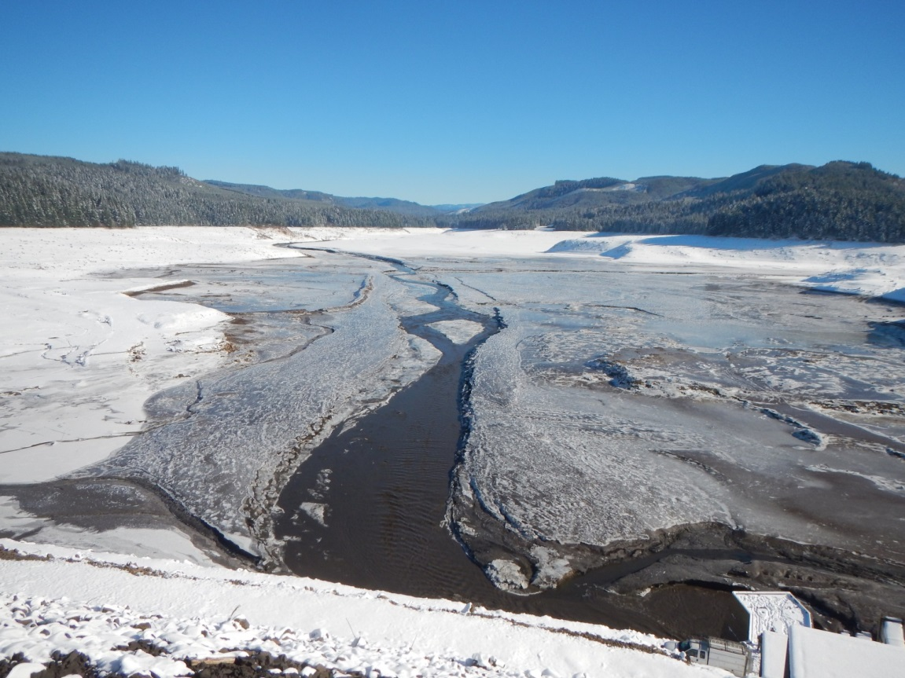
2012 and 2013 Deep Drawdowns

Slide 7
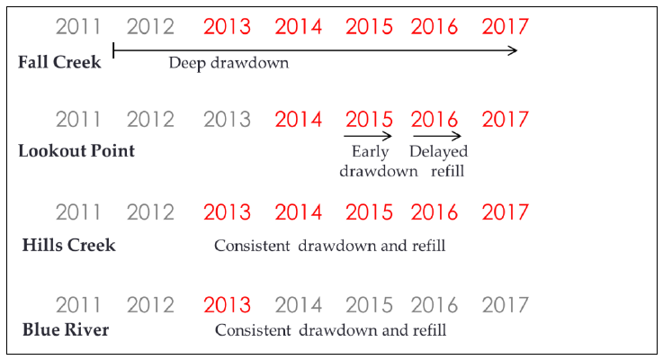
Project Timeline

Slide 8
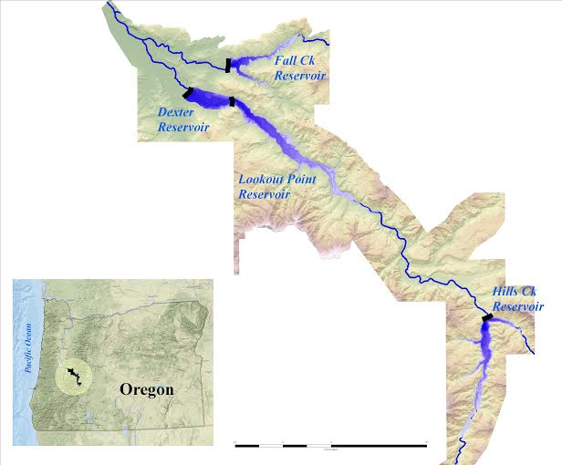
Sampling design
N
1
Space
2
C
4
3
Full-pool sampling
  Multiple depths x sites x times
  Chemistry, light, T°, conductivity, pH, Chl α, phytoplankton, zooplankton, invertebrates, fish (fin clips)
Drawdown sampling
  Outflow water chemistry
Notes:
Most of the depth profiles will be from the core, deepest site – REPLACE MAP

Slide 9
Less light penetration in Fall Creek
Depth in feet where light is 10% of surface irradiance
  Influenced by suspended sediments, DOC and algae blooms
Month | Fall Creek | Hills Creek | Lookout Point
May/June, 2014 | 13.0 | 16.8 | 16.1
July, 2014 | 15.4 | 22.9 | 20.4
August, 2014 | 17.2 | 21.6 | 21.0
Notes:
Could mention BR for reference

Slide 10
Less light penetration in Fall Creek
Depth in feet where light is 10% of surface irradiance
  Influenced by suspended sediments, DOC and algae blooms
Month | Fall Creek | Hills Creek | Lookout Point
May/June, 2014 | 13.0 | 16.8 | 16.1
July, 2014 | 15.4 | 22.9 | 20.4
August, 2014 | 17.2 | 21.6 | 21.0
August, 2013 | 16.4 | 29.1
Notes:
Could mention BR for reference

Slide 11
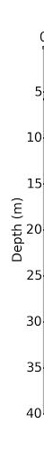
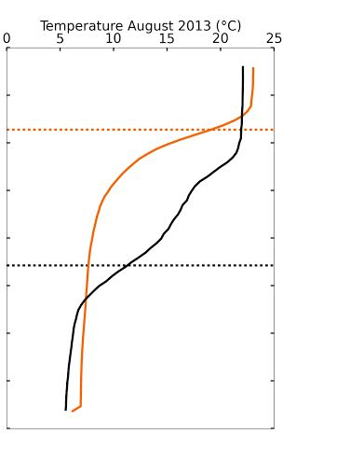

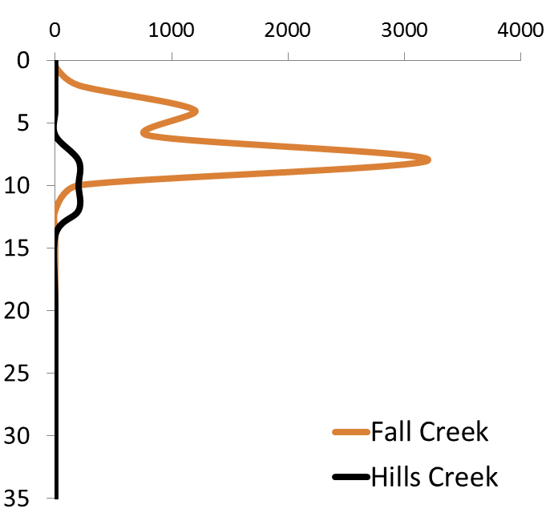
Thermocline is shallower in Fall Creek
(ft)
15
30
45
60
75
90
105
120
30 40 50 60 70 75 (°F)
Notes:
MAYBE REMOVE

Slide 12
Thermocline is shallower in Fall Creek
Month | Fall Creek | Hills Creek | Lookout Point
May/June, 2014 | 5.8 | 5.8 | 6.1
May/June, 2013 | 7.1 | 8.7
August, 2014 | 9.7 | 20.6 | 10.3
August, 2013 | 9.5 | 22.5

Slide 13
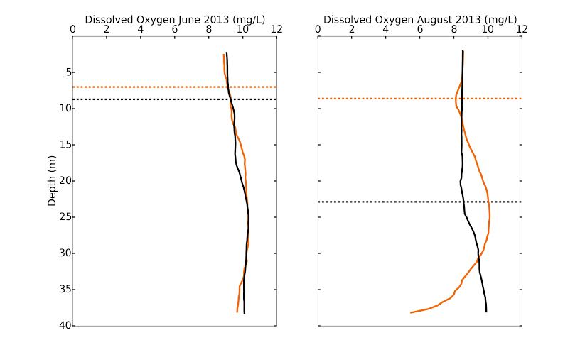
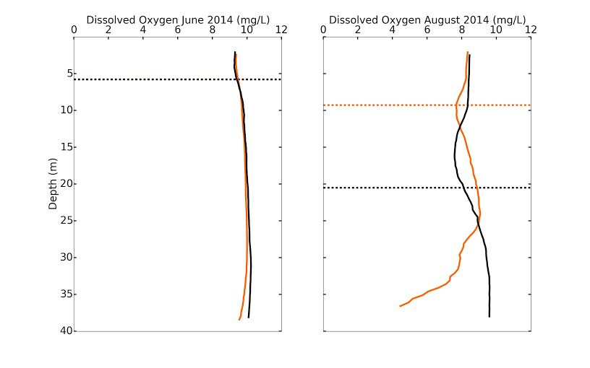
Similar oxygen demand in June
2013
2014
min
Notes:
None of the reservoirs was hypoxic – bring notes on minimum add thermocline
The dissolved oxygen profile in Fall Creek shows greater evidence of oxygen consumption below the thermocline
This is true both in comparison to Hills Creek and Lookout Point, but also across years

Slide 14
More oxygen demand in August

Slide 15
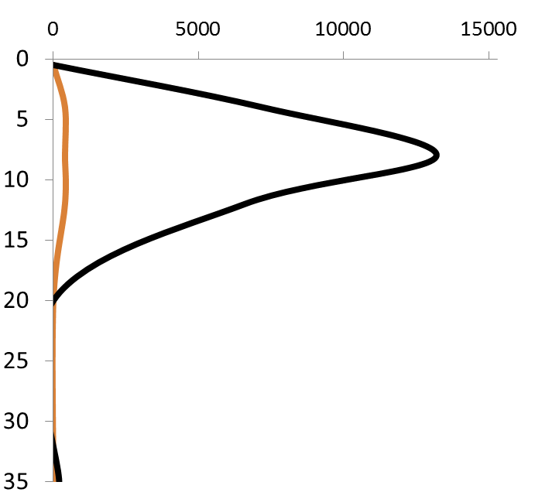
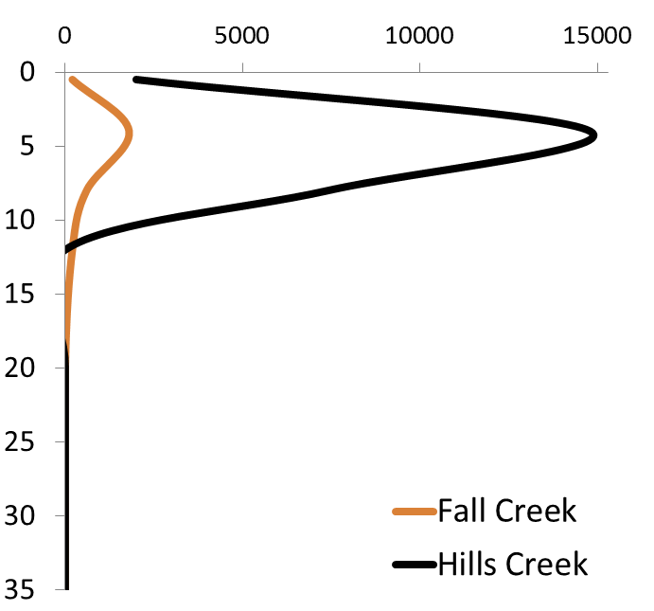
Less abundant Daphnia in Fall Creek in June
Daphnia / m³ in June 2013
Daphnia / m³ in June 2014

Slide 16
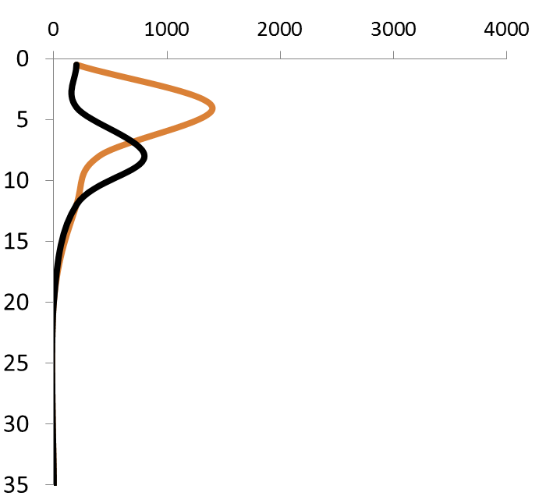
More abundant Daphnia in Fall Creek in August
Daphnia / m³ in August 2013
Daphnia / m³ in August 2014

Slide 17
Findings in Fall Creek
The light transmission and thermocline were similar across years, and continue to suggest sediment resuspension following deep drawdown.
The DO curve indicates higher oxygen demand in Fall Creek Reservoir.
Zooplankton collections suggest strong seasonal dynamics with lower June abundance and higher August abundance in Daphnia.

Slide 18

Bioenergetics in Reservoirs
Bioenergetics modelling can give us a way to predict changes in growth with changes in:
  Temperature
  Light
  Zooplankton
including the overlap in these groups.
Consumption
Growth and Metabolism
Excretion
Egestion
Notes:
USE DRAWN CHINOOK

Slide 19
Modelling Chinook Salmon Consumption of Daphnia
Search Volume
Reaction Distance
ER_{z,t} = (π 3.787L^{0.4747}_{z,t} TL^{0.9463})²_{z,t} SS_{t} PD_{z,t}
ER = Encounter Rate (prey per hour at depth z and diel time period t)
L = Light (lux)
TL = Total Length (of prey)
SS = Swimming Speed
PD = Prey Density (vertical distribution)
Mazur and Beauchamp 2006

Slide 20
Parameters for BioE Modelling
Temperature strata
Light extinction coefficient
Predicted Chinook depth in June vs. August
  Optimal growth temp 15.5 °C (Jobling 1981)
Prey densities (PD; Daphnia) at predicted depth
Encounter rate (ER) at depth based on light
Total volume available
Optimal growth temperatures of
  Largemouth Bass 28.1 and 28.6 °C (Díaz et al. 2007)
  Rainbow Trout 16.5 to 17.2 °C (Jobling 1981)

Slide 21
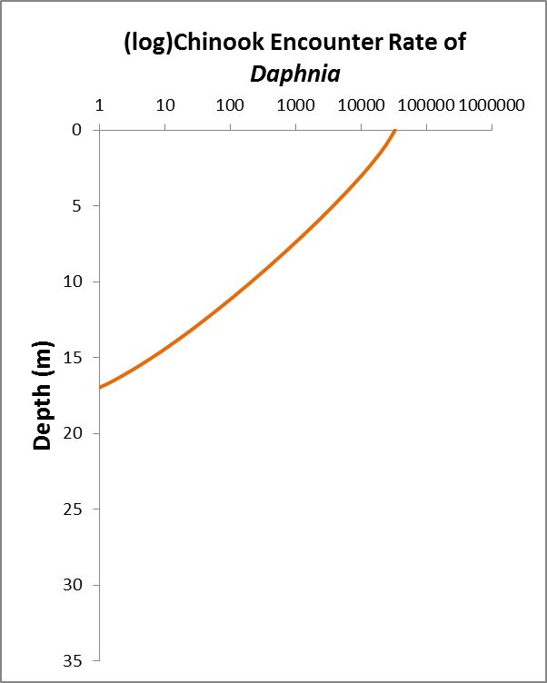
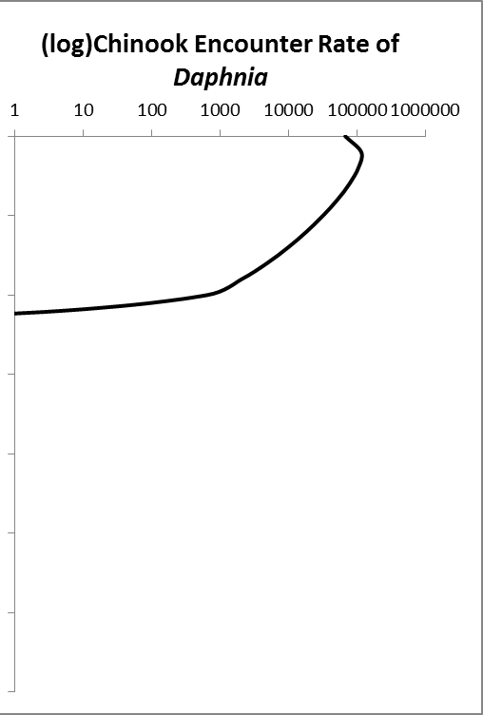
18°C
18°C
12°C
12°C
June
Notes:
LABEL AXES

Slide 22
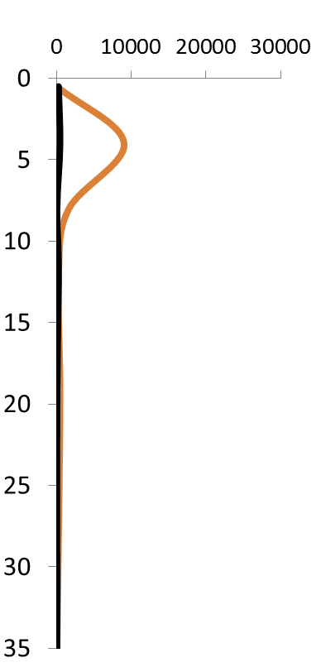
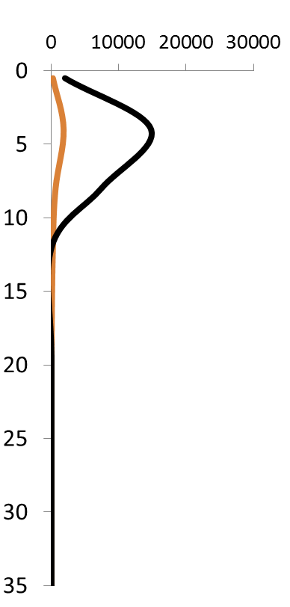
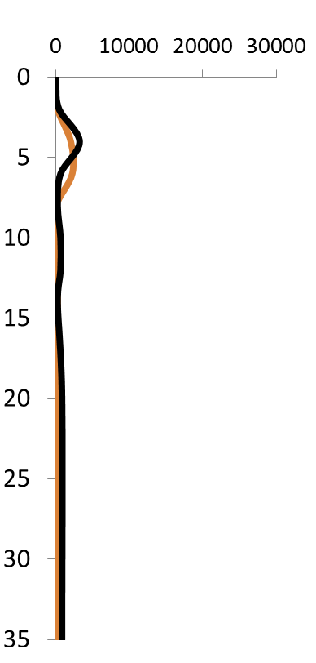
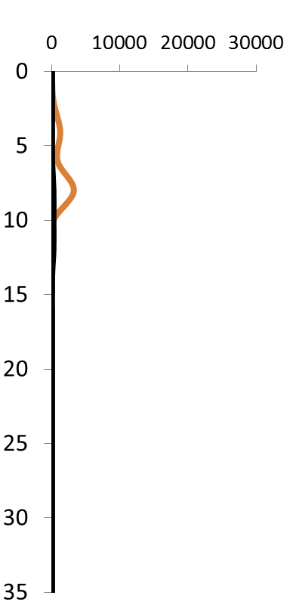
Fall Creek Daphnia Densities Change Through the Summer (# / m³)
May
June
July
August

Slide 23
Potential tradeoffs of deep drawdown:
Decreased water clarity
  Via increased resuspension of fine sediments
Decreased oxygen at depth
Altered seasonal zooplankton availability
Increased potential for spatial overlap of juvenile Chinook Salmon and zooplankton prey
  Potential for increasing growth rates
Increased exposure to remaining warm water *predators* with contraction of temperature zones
We expect resuspension to decrease across years, likely reducing these effects…

Slide 24
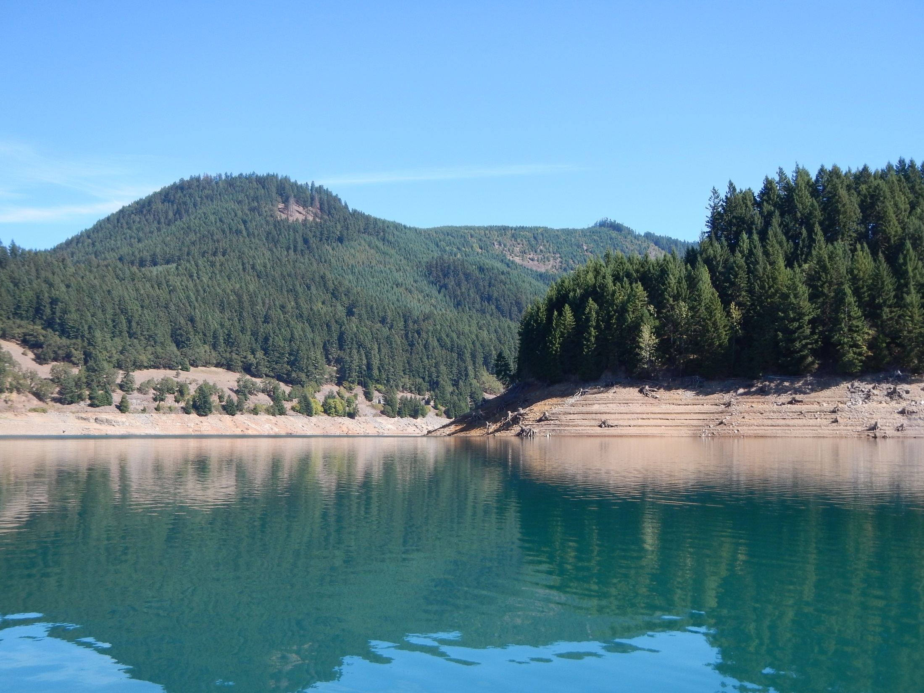
Questions?

